Slide 1
Final Demo: HEART MONITOR
By:
Yahia Hassanein

Slide 2
APPROACH
Set sampling rate depending on timers
Wait for required parameters and signal to start conversion
Transmit Readings via UART
Receiving Readings via PySerial
Display Data using Funcanimation
Finding bpm using Heartpy
GUI using Tkinter

Slide 3
C code (Acquiring the sampling rate and calculating the timer)
while(HAL_UART_Receive(&huart1, (uint8_t *) rate, sizeof(rate), 2500) || (z==2)) {
if(rate[0] == 'r')
{
result = strtol(rate + 1, &eptr, 10);
samp = (1000000 / result) - 1;
rate[0] = 'x';
z--;
}
}
while(HAL_UART_Receive(&huart1, (uint8_t *) rate, sizeof(rate), 2500) && (z==1))
{
if( rate[0] == 's')
{
rate[0] = 'x';
z--;
}
}

Slide 4
GUI
User chooses COM Port and Baudrates from the given options
User Can’t set Sampling rate unless COM Port and Baudrate are set
User Can’t Start conversion Unless Sampling rate COM Port and Baudrate are set
After that user will be able to view the graph
At the end, user can decide to view the heart rate in bpm or not before app restart again

Slide 5
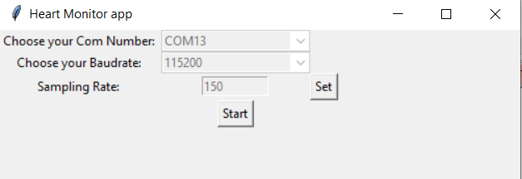
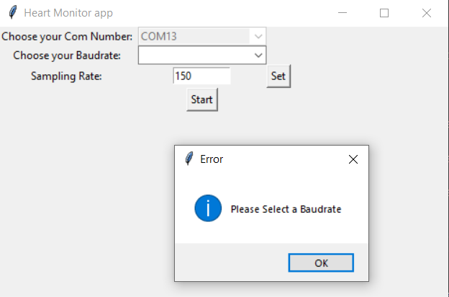
GUI

Slide 6
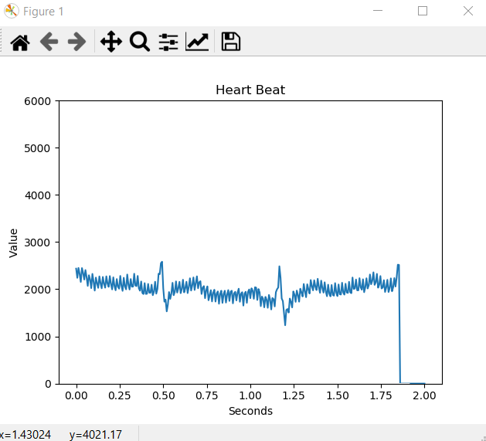
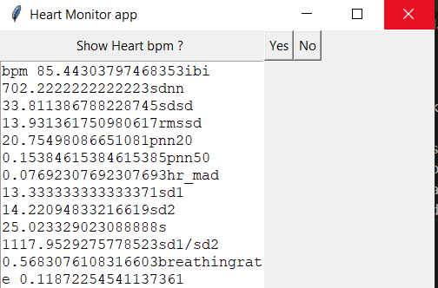
GUI

Slide 7
C code (Handling ADC Conversions)
HAL_ADC_Start(&hadc1);
HAL_ADC_Stop(&hadc1);
HAL_ADC_PollForConversion (&hadc1, 1000);
val = HAL_ADC_GetValue (&hadc1);

Slide 8
C code (Acquiring and Transmiting 1-minute worth of data)
it = result * 60; //Number of samples required
while (x < it)
{
HAL_ADC_PollForConversion (&hadc1, 1000);
htim1.Instance ->CNT = 0;
val = HAL_ADC_GetValue (&hadc1);
n = sprintf(out, "%u", val);
out[n] = '\n’;
HAL_ADC_Stop(&hadc1);
HAL_UART_Transmit(&huart1,(uint8_t *) out, n+1, 1000);
while(htim1.Instance ->CNT < samp){} //Timer to take samples from ADC
x++;
HAL_ADC_Start(&hadc1);
}

Slide 9
Python (Plotting Funcanimation)
def init():
line.set_ydata([])
return line, def animate(i, ys): # Read ADC Transmitted Values
out = ser.readline().decode("ascii")
if out != '':
out1 = int(out)
d.append(out1)
else:
out1=0
# Add y to list
ys.append(out1) # Limit y list to set number of items
ys = ys[-x_len:] # Update line with new Y values
line.set_ydata(ys) return line,

Slide 10
Python (Plotting Funcanimation)
x_len = 301 # Number of points to display
y_range = [0, 6000] # Range of possible Y values to display fig = plt.figure() ax = fig.add_subplot(1, 1, 1)
xs = list([0 + (x * (2/300)) for x in range(0, 301)])
ys = [0] * x_len
ax.set_ylim(y_range) # Create a blank line. We will update the line in animate
line, = ax.plot(xs, ys) #Add labels
plt.title('Heart Beat')
plt.xlabel('Seconds')
plt.ylabel('Value') animation.FuncAnimation(fig, animate, init_func=init, frames=9002, fargs=(ys,), interval=6.6667, blit=True)
plt.show()

Slide 11
Python (HeartPy)
wd, m = hp.process(np.array(d), 150)
for measure in m.keys():
configfile.insert(END, (measure, m[measure]))
ser = serial.Serial()
ser.port = comboExample.get()
ser.baudrate = int(combo2.get())
ser.bytesize = serial.EIGHTBITS
ser.timeout = 1
ser.parity = serial.PARITY_NONE
ser.open()
ser.close()
Python (Pyserial)

Slide 12
Python (Tkinter)
window = Tk()
window.title("Heart Monitor app")
window.geometry('500x300')
labelTop2 = Label(window , text = "Choose your Baudrate: ")
labelTop2.grid(column=0, row=1)
# Set Baudrate after getting it from the combobox
def callbackFunc2(event):
global flag
ser.baudrate = int(combo2.get())
flag = flag + 1
combo2.config(state= "disabled") combo2 = ttk.Combobox(window, values=["9600", "57600", "115200"])
combo2.grid(column=1, row=1)
combo2.bind("<<ComboboxSelected>>", callbackFunc2)
txt = Entry(window,width=10)

Slide 13
Python (Tkinter)
def clicked1():
global flag
if flag == 0:
messagebox.showinfo('Error', 'Please Select a COM Port')
elif flag == 1:
messagebox.showinfo('Error', 'Please Select a Baudrate')
elif flag == 2:
messagebox.showinfo('Error', 'Please Select a Sampling Rate')
ser.write(b's5555')
window.destroy()
btn = Button(window, text="Start", command=clicked1)
btn.grid(column=1, row=3)
configfile = Text(window1, wrap=WORD, width=30, height= 15)

Slide 14
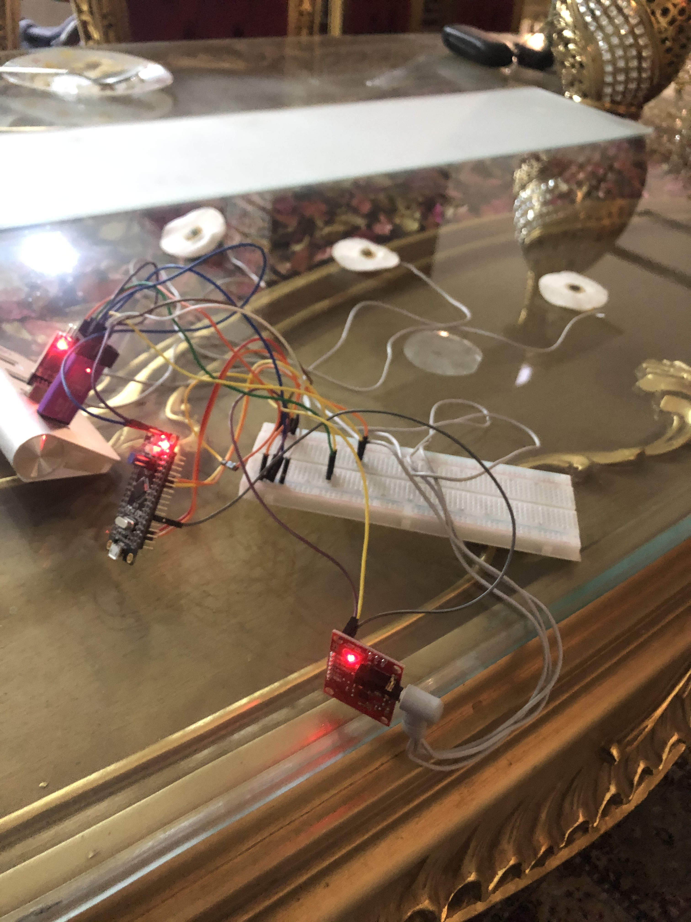
Hardware Connection

Slide 15
Any Questions ?

